Slide 1
SAP HANA Multitenant Database Containers (MDC)

Slide 2
Multitenancy - Introduction
SAP HANA multitenant database containers establishes a foundation for providing multitenancy in SAP HANA
Multitenancy refers to a principle in software architecture where a single instance of the software runs on a server, serving multiple tenants. A tenant is a group of users sharing the same view on a software they use. With a multitenant architecture, a software application is designed to provide every tenant a dedicated share of the instance including its data, configuration, user management, tenant individual functionality and non-functional properties. Multitenancy contrasts with multi-instance architectures where separate software instances operate on behalf of different tenants. From http://en.wikipedia.org/wiki/Multitenancy

Slide 3
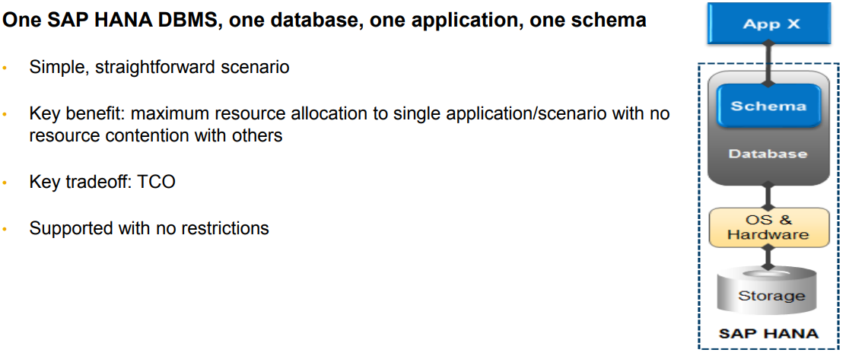
Standard SAP HANA Deployment Scenario

Slide 4
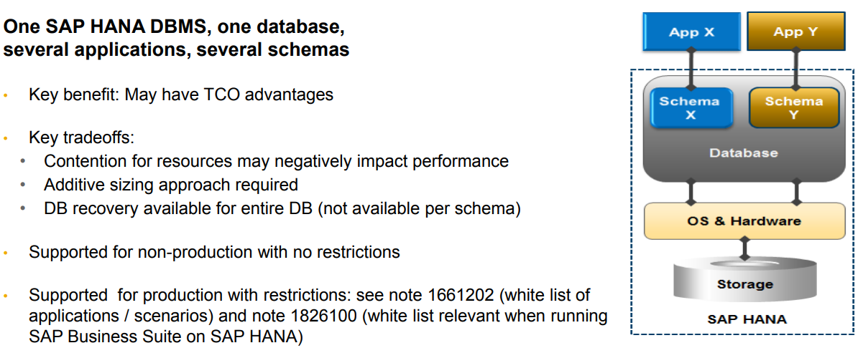
Multiple Applications on One SAP HANA system Multiple Components One Database (MCOD)

Slide 5
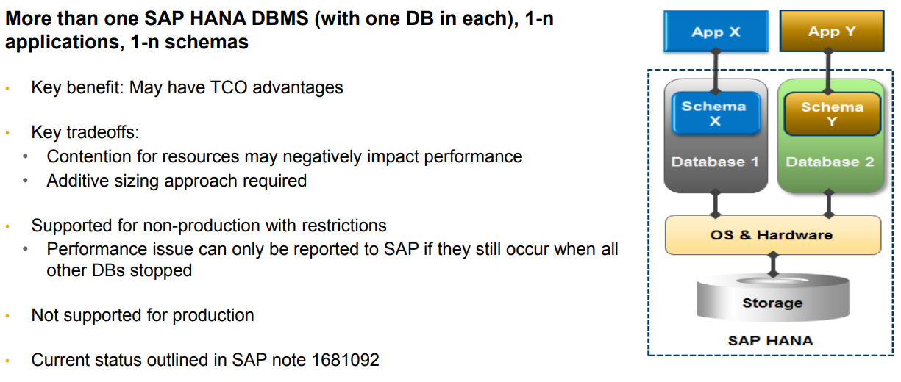
Several Databases on One SAP HANA System Multiple Components One System (MCOS)

Slide 6
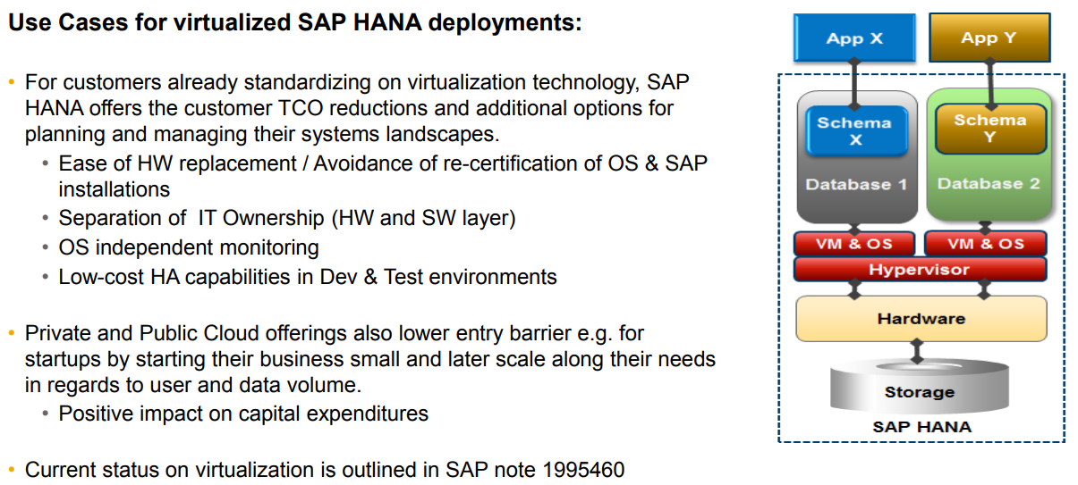
SAP HANA virtualized

Slide 7
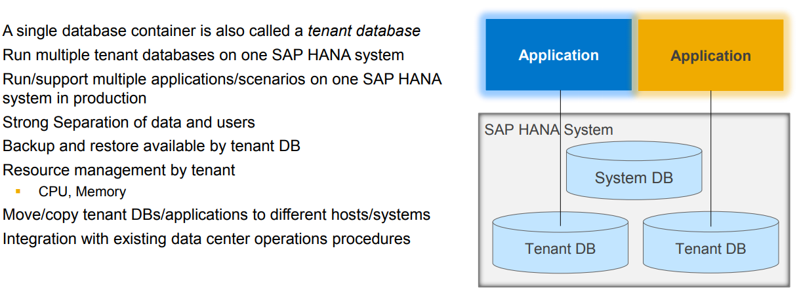
SAP HANA multitenant database containers Concept and Terminology

Slide 8
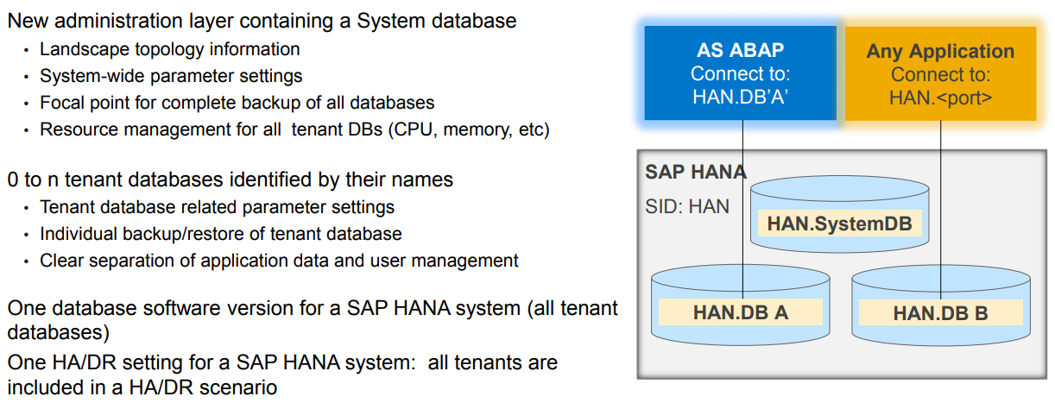
SAP HANA Multitenant database containers

Slide 9
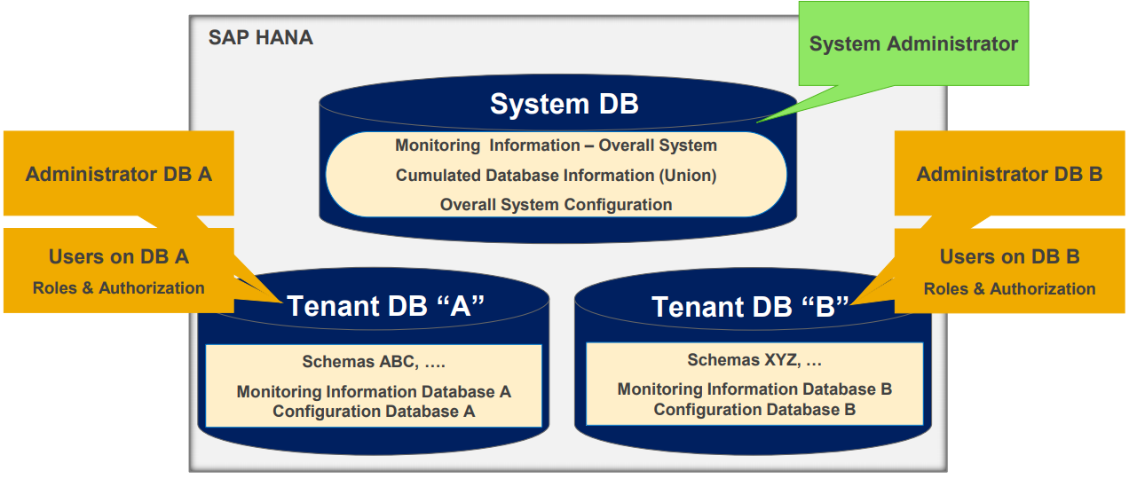
SAP HANA multitenant database containers User and Administration Layers

Slide 10
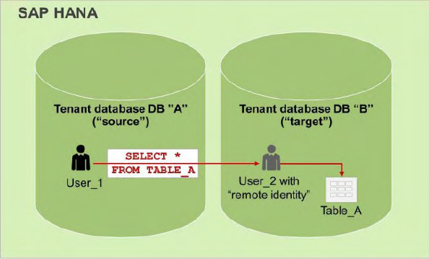
Cross-Tenant Database Access
A user in one database can run a query that references objects in another database if the user is associated with a sufficiently privileged user in the remote database. This associated user is called a remote identity. This is the user who executes the query (or part of the query) in the remote database and therefore the user whose authorization is checked.
Cross-database access is not enabled by default and must be configured before such user mappings can be set up.
By default cross database access between tenants is inactive.
To be able to run queries spanning multiple tenant databases
the global cross database access switch has to be turned on.

Slide 11
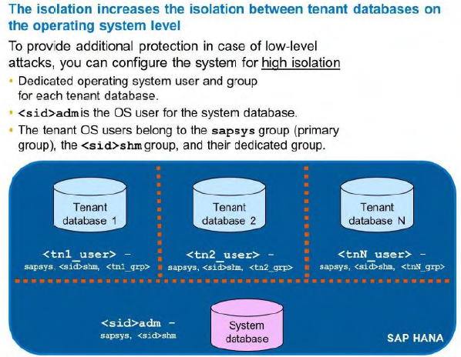
Isolation of a Tenant Database

Slide 12
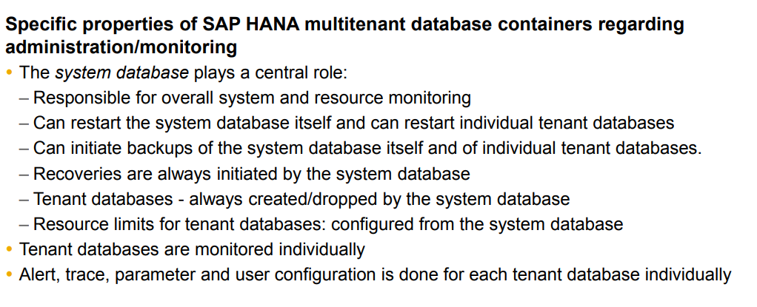
Improved Monitoring and Supportability Multitenant Database Containers: Administration

Slide 13
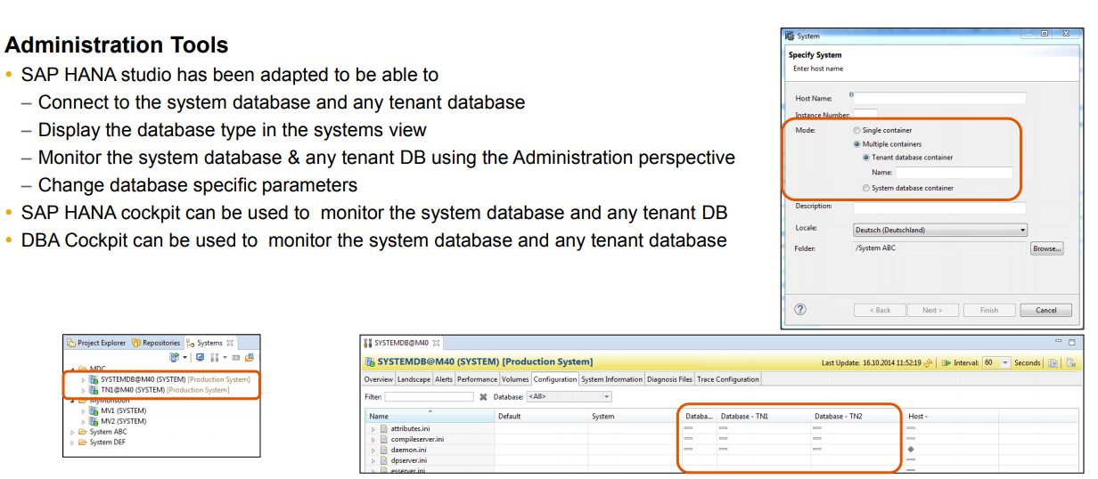
Improved Monitoring and Supportability SAP HANA Multitenant Database Containers: Administration Tools

Slide 14
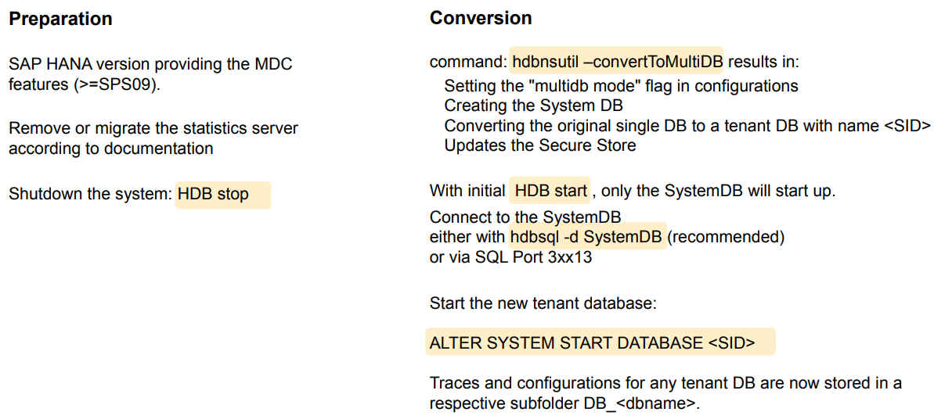
Migration to a Tenant Database

Slide 15
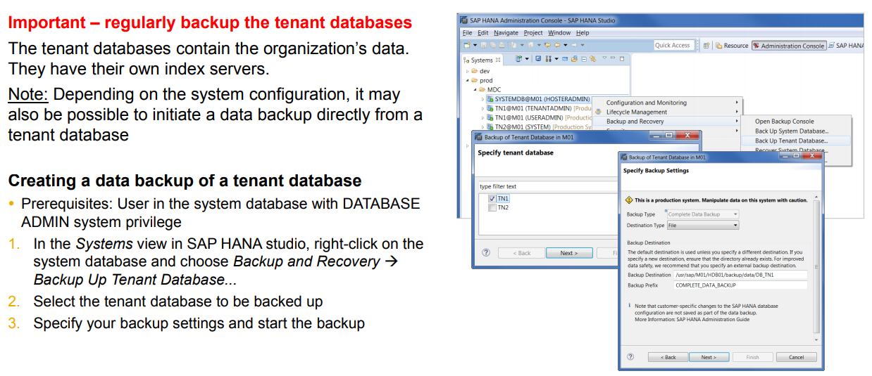
Backing up a Tenant Database

Slide 16
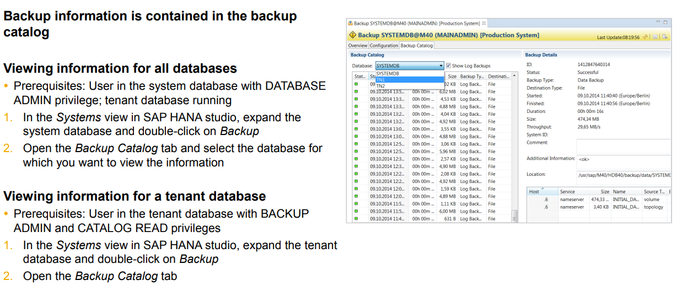
Viewing Backup Information

Slide 17
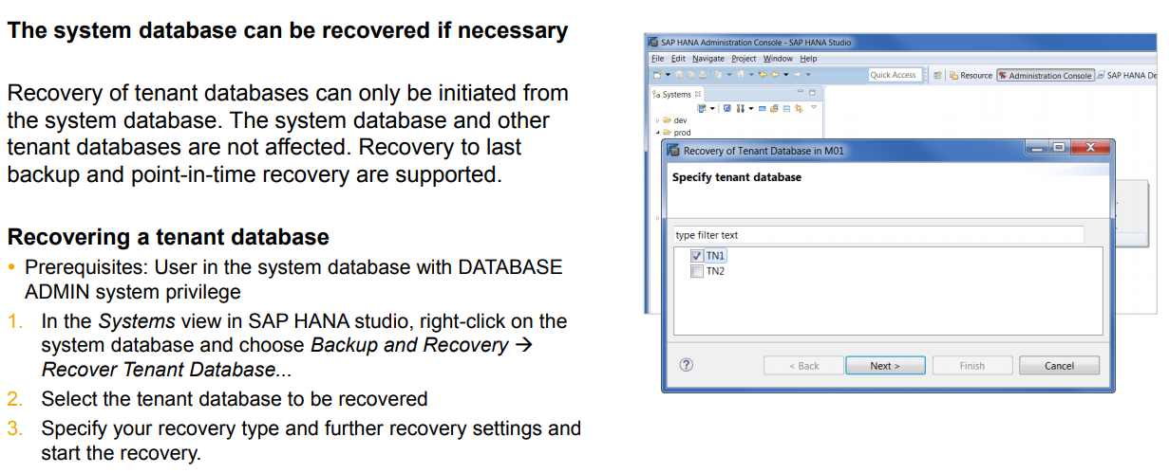
Recovering a Tenant Database

Slide 18
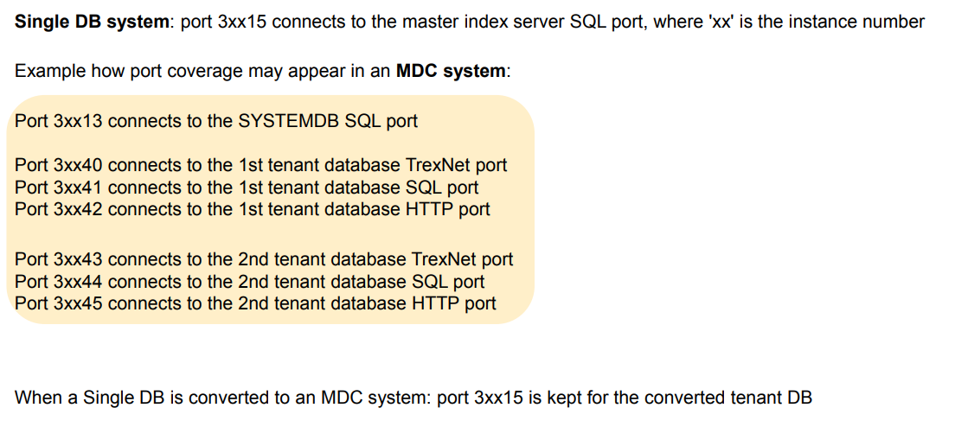
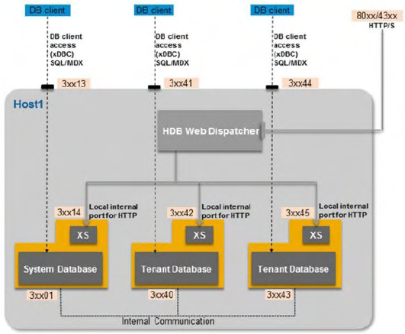
Connecting to Tenant Databases – Port Coverage

Slide 19
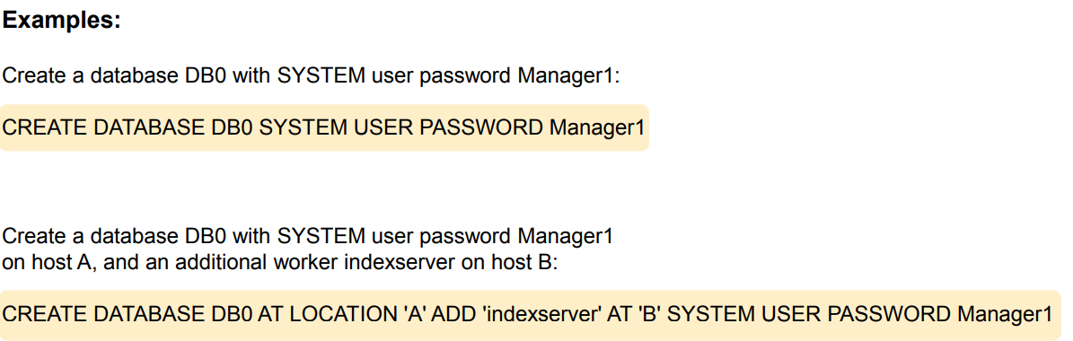
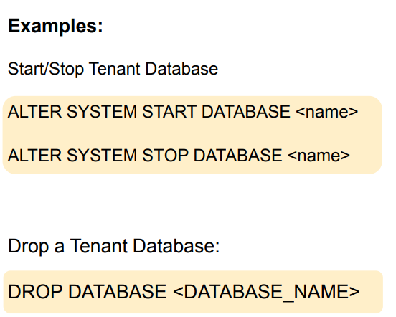
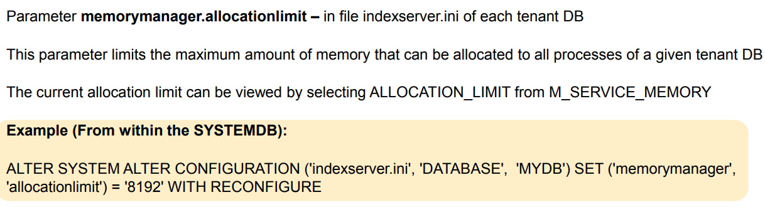
Tenant Databases

Slide 20
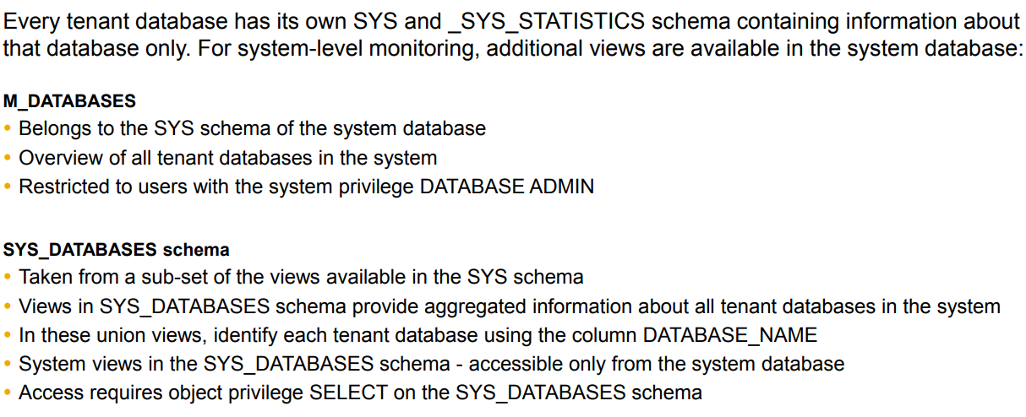
System Monitoring - Views
In a system with multitenant database containers, the trace files of the system database are stored at the default location: /usr/ sap/<SID>/HDB<instance>/<host> /trace
Trace files of tenant databases are stored in a sub-directory named DB_<dbname>.

Slide 21
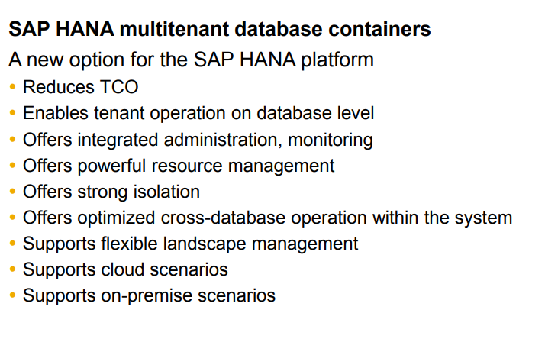
Summary

